Slide 1
Revitalize or Restart- A Guide for French Teachers
Alexis Thornton
NYSAFLT Annual Conference October 20, 2017

Slide 2
Who am I?
School-related
French (all levels)/ Spanish Teacher (levels 1-3Honors)
Teacher Mentor
Department Coordinator
Advise: World Language Club/ French Honor Society
1-to-1 Laptops
NYSAFLT-related
President of Putnam, Westchester Region Foreign Language Educators
Presenter at conferences
Scholarship winner

Slide 3
History of the Program
Start: 2000
Reinvention: 2014
Current Program: French 1
French 2
French 3
French 4

Slide 4
Themes
Level 2:
Qui suis-je?
Qu’est-ce qui m’intéresse?
Level 3:
Où est-ce que je vais?
Comment est-ce que je vais y arriver?

Slide 5
Level 2 Breakdown of Topics
Date/ Seasons/ Numbers/ Time
Family/ Animals
House & Home
Food & Food Preparation
Communication
  Telephone, Computer
Reflexives/ Health
Appearance
***Salade soap opera
First day of school: Write an answer to the thematic questions: can be in list form, sentence or paragraph. File answers in a folder as a benchmark.
End of school year: Hand back their answers, expand on essay to write 150 words!

Slide 6
Level 3 Breakdown of Topics
Shopping
Activities/ Pastimes
Maghreb
Transportation
  Cars, trains, subway, airplanes
Celebrations in Francophone Countries
Social/ Environmental Impact
***Salade Soap Opera Trial
FLACS Exam to end Level 3!

Slide 7
Daily Do Nows
Cartoons/ graphics (introduce a topic, reinforce vocabulary or grammar)
Daily on Google classroom
Weekly submissions

Slide 8
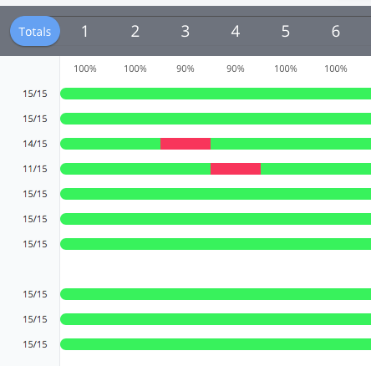
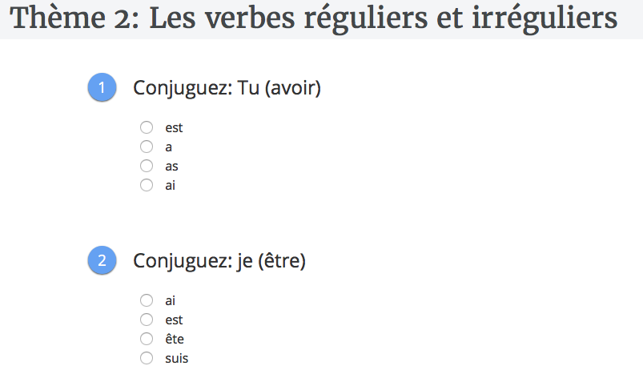
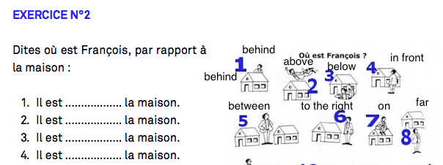
Goformative.com

Slide 9
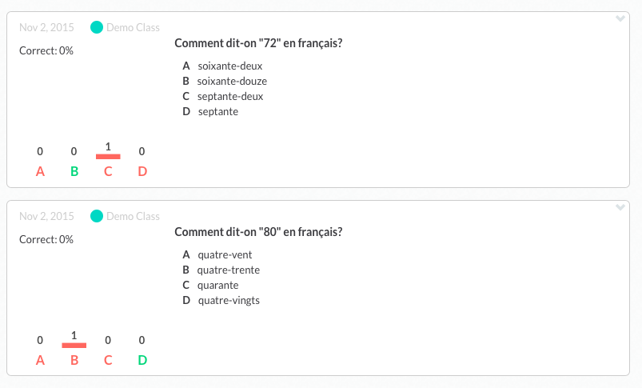
Plickers.com
Let’s try one!

Slide 10
Communicative/ Interactive
A-B partner activities (crossword puzzles, describe a picture, etc.)
Frog game
Pig game
Dominoes
Whiteboards
Breakout Activities (digital and physical boxes)
Dice
Manipulatives
Bingo games

Slide 11

A- B Info Gap Activity
Take picture- make 2 versions in which you delete out some pictures. Students must describe to their partner the image to see what’s missing!

Slide 12
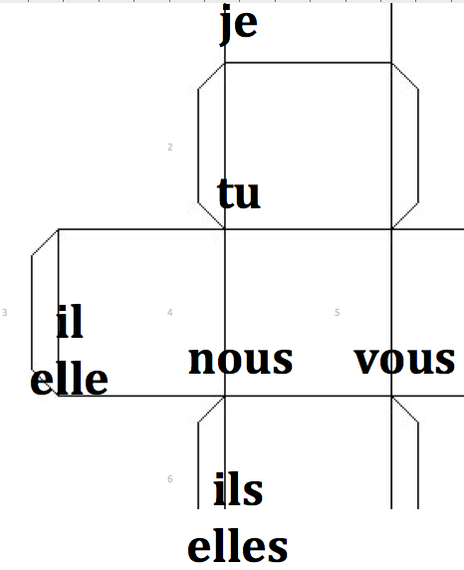
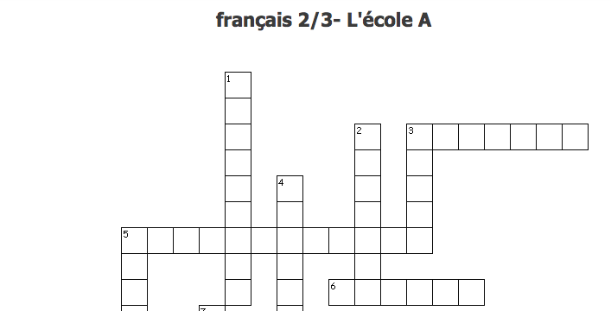
Additional Communicative Activities
One die for verbs, one for pronouns- conjugate, turn into sentences, etc.!
A & B crosswords- partner has clues!

Slide 13
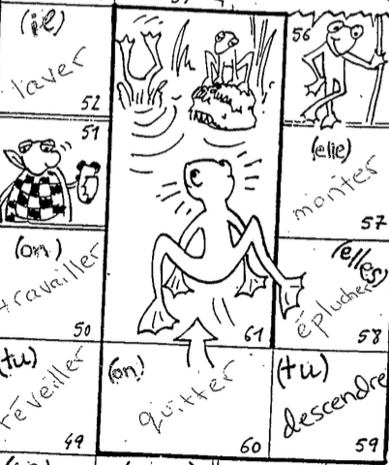
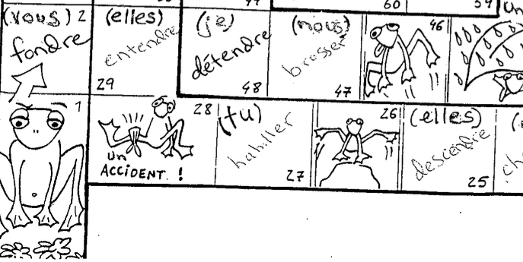
Example of Frog Game (grammar):
Roll- conjugate (out loud or written).

Slide 14
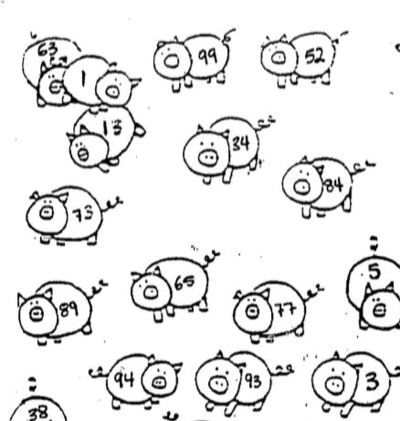
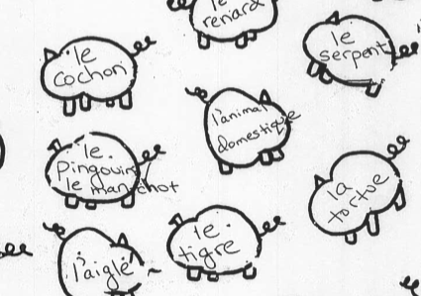
Examples of Pig Game:
Use with vocabulary (add noun markers), verb identification, verb conjugation.

Slide 15
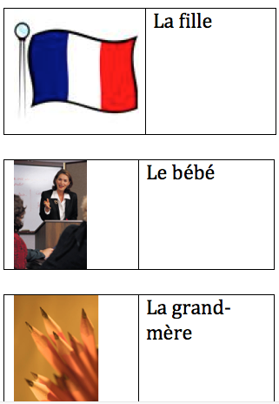
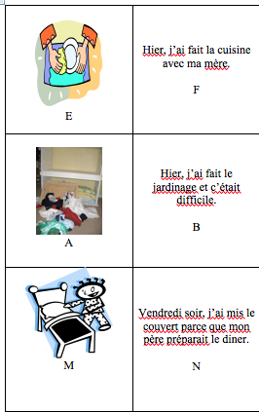
Dominoes (use creativecommons.org for images)

Slide 16
Soap Opera
See Video!
Bi-weekly throughout the school year in level 2, carries into level 3!
Les Contes de Salade (Teacher’s Discovery) by Stephanie L. Campbell
Book Information

Slide 17
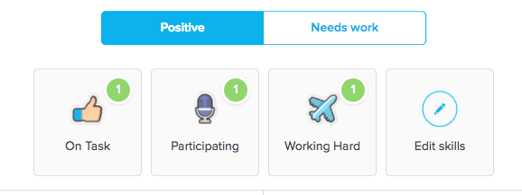
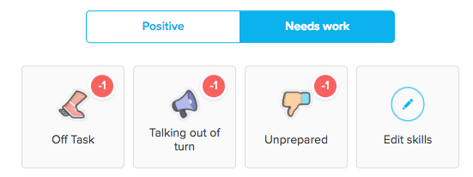
Tracking Class Participation- Class Dojo
Level 1- I create categories
Level 2+- students help create categories

Slide 18
Technology-Driven
Resources: Google Classroom PLUS
https://edpuzzle.com/
https://conjuguemos.com/
https://goformative.com/
https://quizlet.com/
https://www.quia.com/
https://info.flipgrid.com
http://www.wordreference.com/
https://kahoot.com/
http://www.castlelearning.com
https://portaportal.com
https://padlet.com/
https://www.plickers.com/

Slide 19
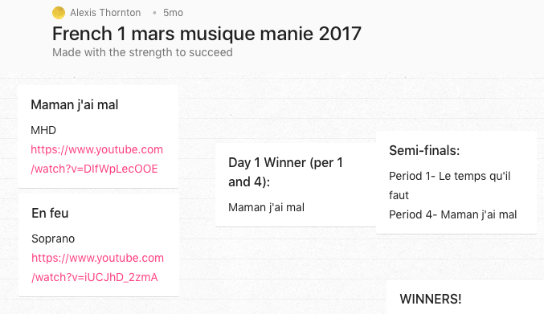
Musique
Music Bracket
- Use padlet.com
to display videos
- Use pollev.com
to vote daily!

Slide 20
Celebrations/ Culture
National French Week- Twitter contest
Hosting Students
International Dinner
La Chandeleur- Crêpes
Mardi Gras
National Foreign Language Week- Courts métrages
French National Honor Society- community service
Poisson d’avril
Museum/ Theater Trips

Slide 21
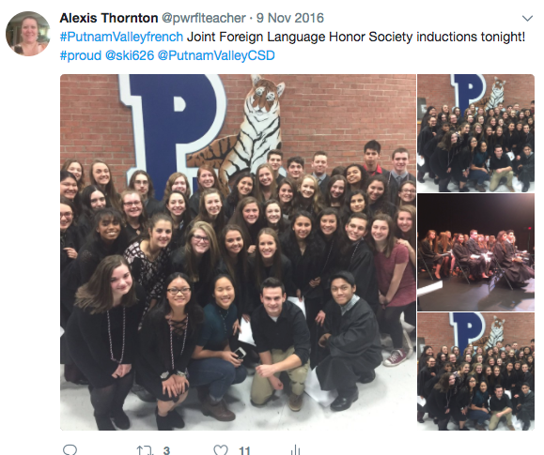
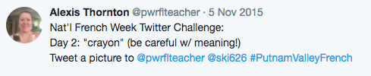
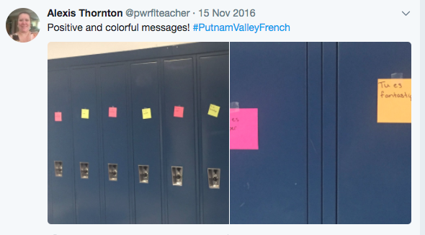
Celebrations

Slide 22



Poisson d’avril
Very specific set of rules! Winning class (by percentage) got a special breakfast!

Slide 23
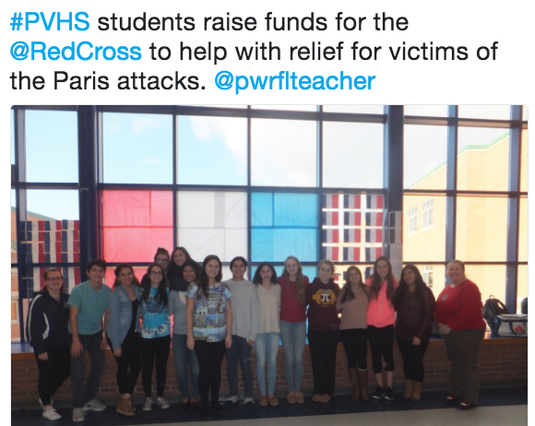
Global Awareness

Slide 24
Teacher Resources:
http://www.education.vic.gov.au/languagesonline/french/french.htm
https://www.tolearnfrench.com
https://fr.islcollective.com/
Conferences!
Facebook Pages:
French Teachers in the US
French Breakout Group
Tech for World Language Teachers
World Language Teachers

Slide 25
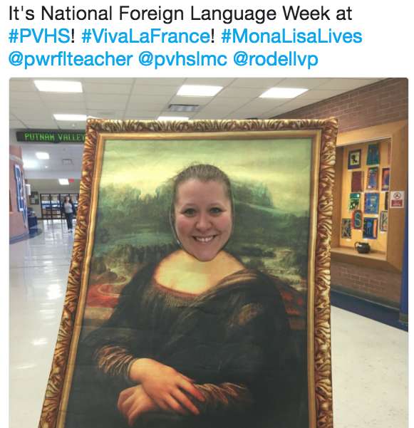
Contact
athornton@pvcsd.org
Twitter: @pwrflteacher
Thank you for coming and
please take a business card
in case I can be of further help!

