Slide 1
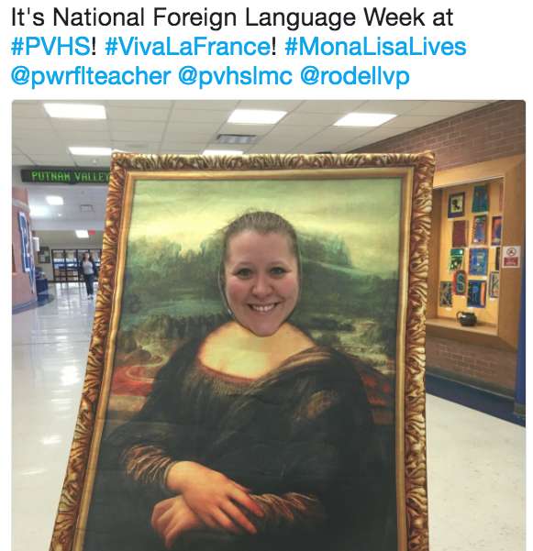
Revitalize or Restart
Alexis Thornton
COLT Conference
March 24, 2018

Slide 2
Who am I?
School-related
French (all levels)/ Spanish Teacher (levels 1-3 Honors)
Teacher Mentor
Department Coordinator
Advise: World Language Club/ French Honor Society
1-to-1 Laptops
NYSAFLT-related
President of Putnam, Westchester Region Foreign Language Educators
Presenter at conferences
Scholarship winner

Slide 3
History of the French Program
Start: 2000
Reinvention: 2014
Current Program: French 1
French 2
French 3
French 4

Slide 4
Themes
Level 2:
Who am I?
What interests me?
Level 3:
Where am I going?
How can I get there?
What impact do I have on other locations?

Slide 5
Level 2 Breakdown of Topics
Date/ Seasons/ Numbers/ Time
Family/ Animals
House & Home
Food & Food Preparation
Communication
  Telephone, Computer
Reflexives/ Health
Appearance
***Salade soap opera
First day of school: Write an answer to the thematic questions: can be in list form, sentence or paragraph. File answers in a folder as a benchmark.
End of school year: Hand back their answers, expand on essay to write 150 words!

Slide 6
Level 3 Breakdown of Topics
Shopping
Activities/ Pastimes
Maghreb
Transportation
  Cars, trains, subway, airplanes
Celebrations in Francophone Countries
Social/ Environmental Impact
***Salade Soap Opera Trial
FLACS Exam to end Level 3!

Slide 7
Level 4 Curriculum:
Student-driven
Choice of topics:
  La Caraïbe
  Canada (Les Acadiens)--> Nouvelle Orléans
  La Musique
  L’histoire de la France
  Provence
  Belle et la Bête
  Les Misérables
  L’histoire de l’art
  Des contes et légendes
Useful resources:
Text: Trésors du Temps
Reader: Contes et légendes du monde francophone
Reader: Contes et légendes de France

Slide 8
Daily Do Nows
Cartoons/ graphics (introduce a topic, reinforce vocabulary or grammar)
Daily on Google classroom
Weekly submissions

Slide 9
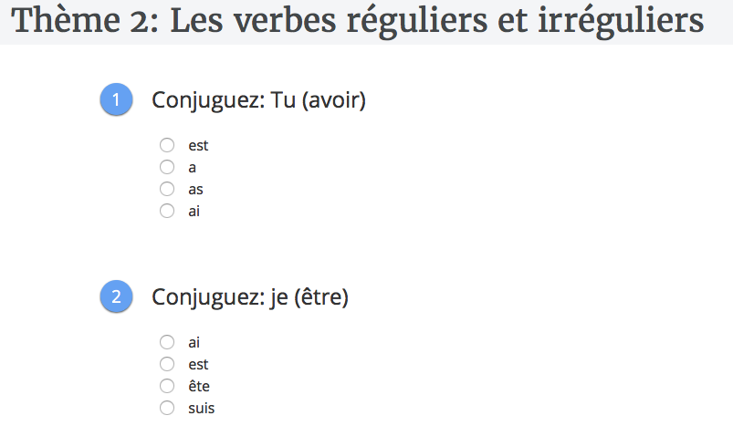
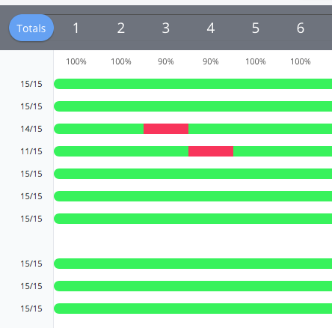
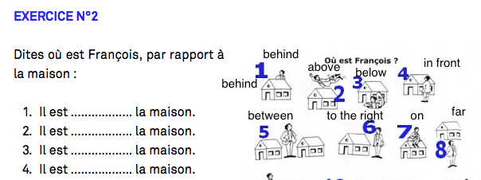
Goformative.com

Slide 10
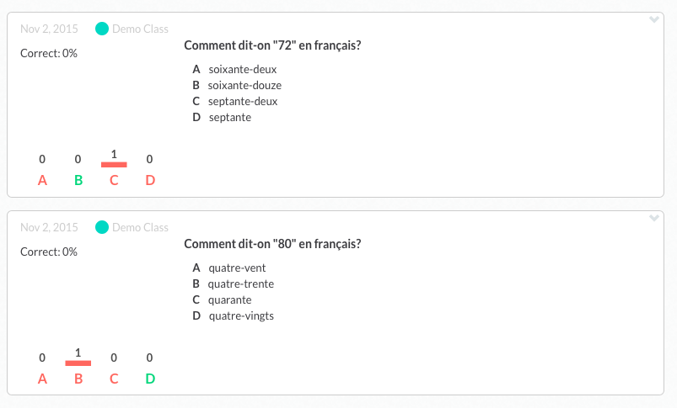
Plickers.com
Let’s try one!

Slide 11
Communicative/ Interactive
A-B partner activities (crossword puzzles, describe a picture, etc.)
Frog game
Pig game
Dominoes
Whiteboards
Breakout Activities (digital and physical boxes)
Dice
Manipulatives
Bingo games

Slide 12

A- B Info Gap Activity
Take picture- make 2 versions in which you delete out some pictures. Students must describe to their partner the image to see what’s missing!

Slide 13
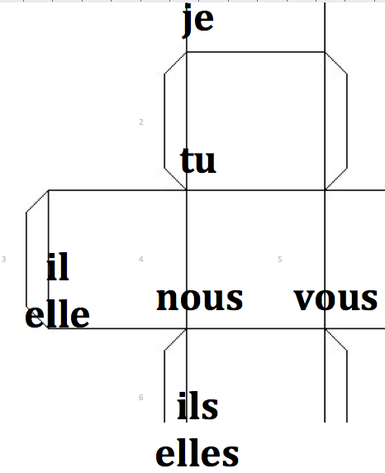
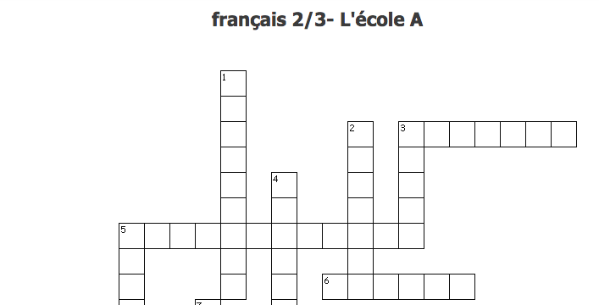
Additional Communicative Activities
One die for verbs, one for pronouns- conjugate, turn into sentences, etc.!
A & B crosswords- partner has clues!

Slide 14
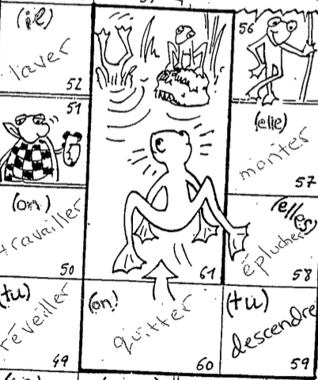
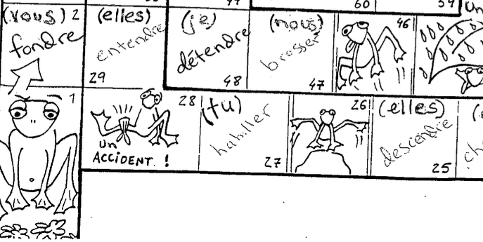
Example of Frog Game (grammar):
Roll- conjugate (out loud or written).

Slide 15
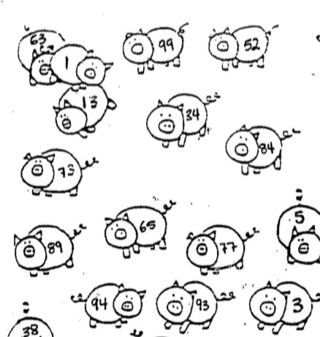
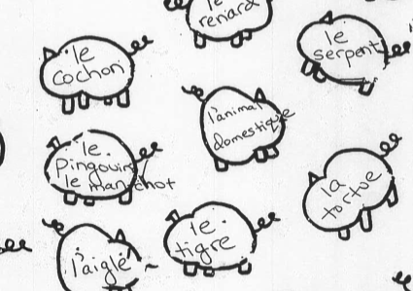
Examples of Pig Game:
Use with vocabulary (add noun markers), verb identification, verb conjugation.

Slide 16
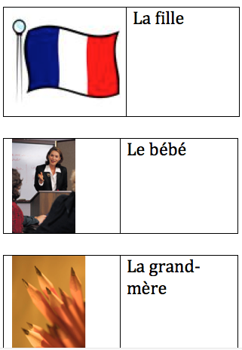
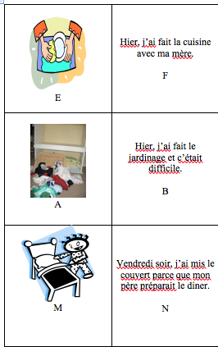
Dominoes (use creativecommons.org for images)

Slide 17
Soap Opera
See Video!
Bi-weekly throughout the school year in level 2, carries into level 3!
Les Contes de Salade (Teacher’s Discovery) by Stephanie L. Campbell
Book Information

Slide 18
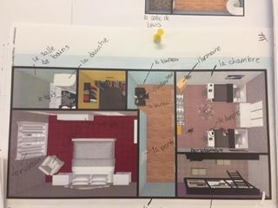
Project- Based
Level 1- House project
Menu project
Who am I project?
Clothing Project

Slide 19
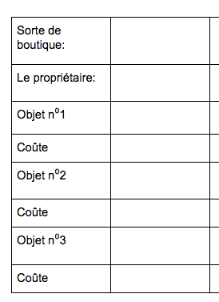
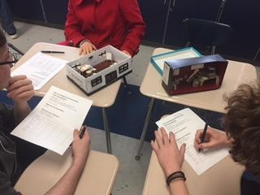
Projects- continued
Level 2- Leisure-time Pop-Up Boutiques
Défilé de mode

Slide 20
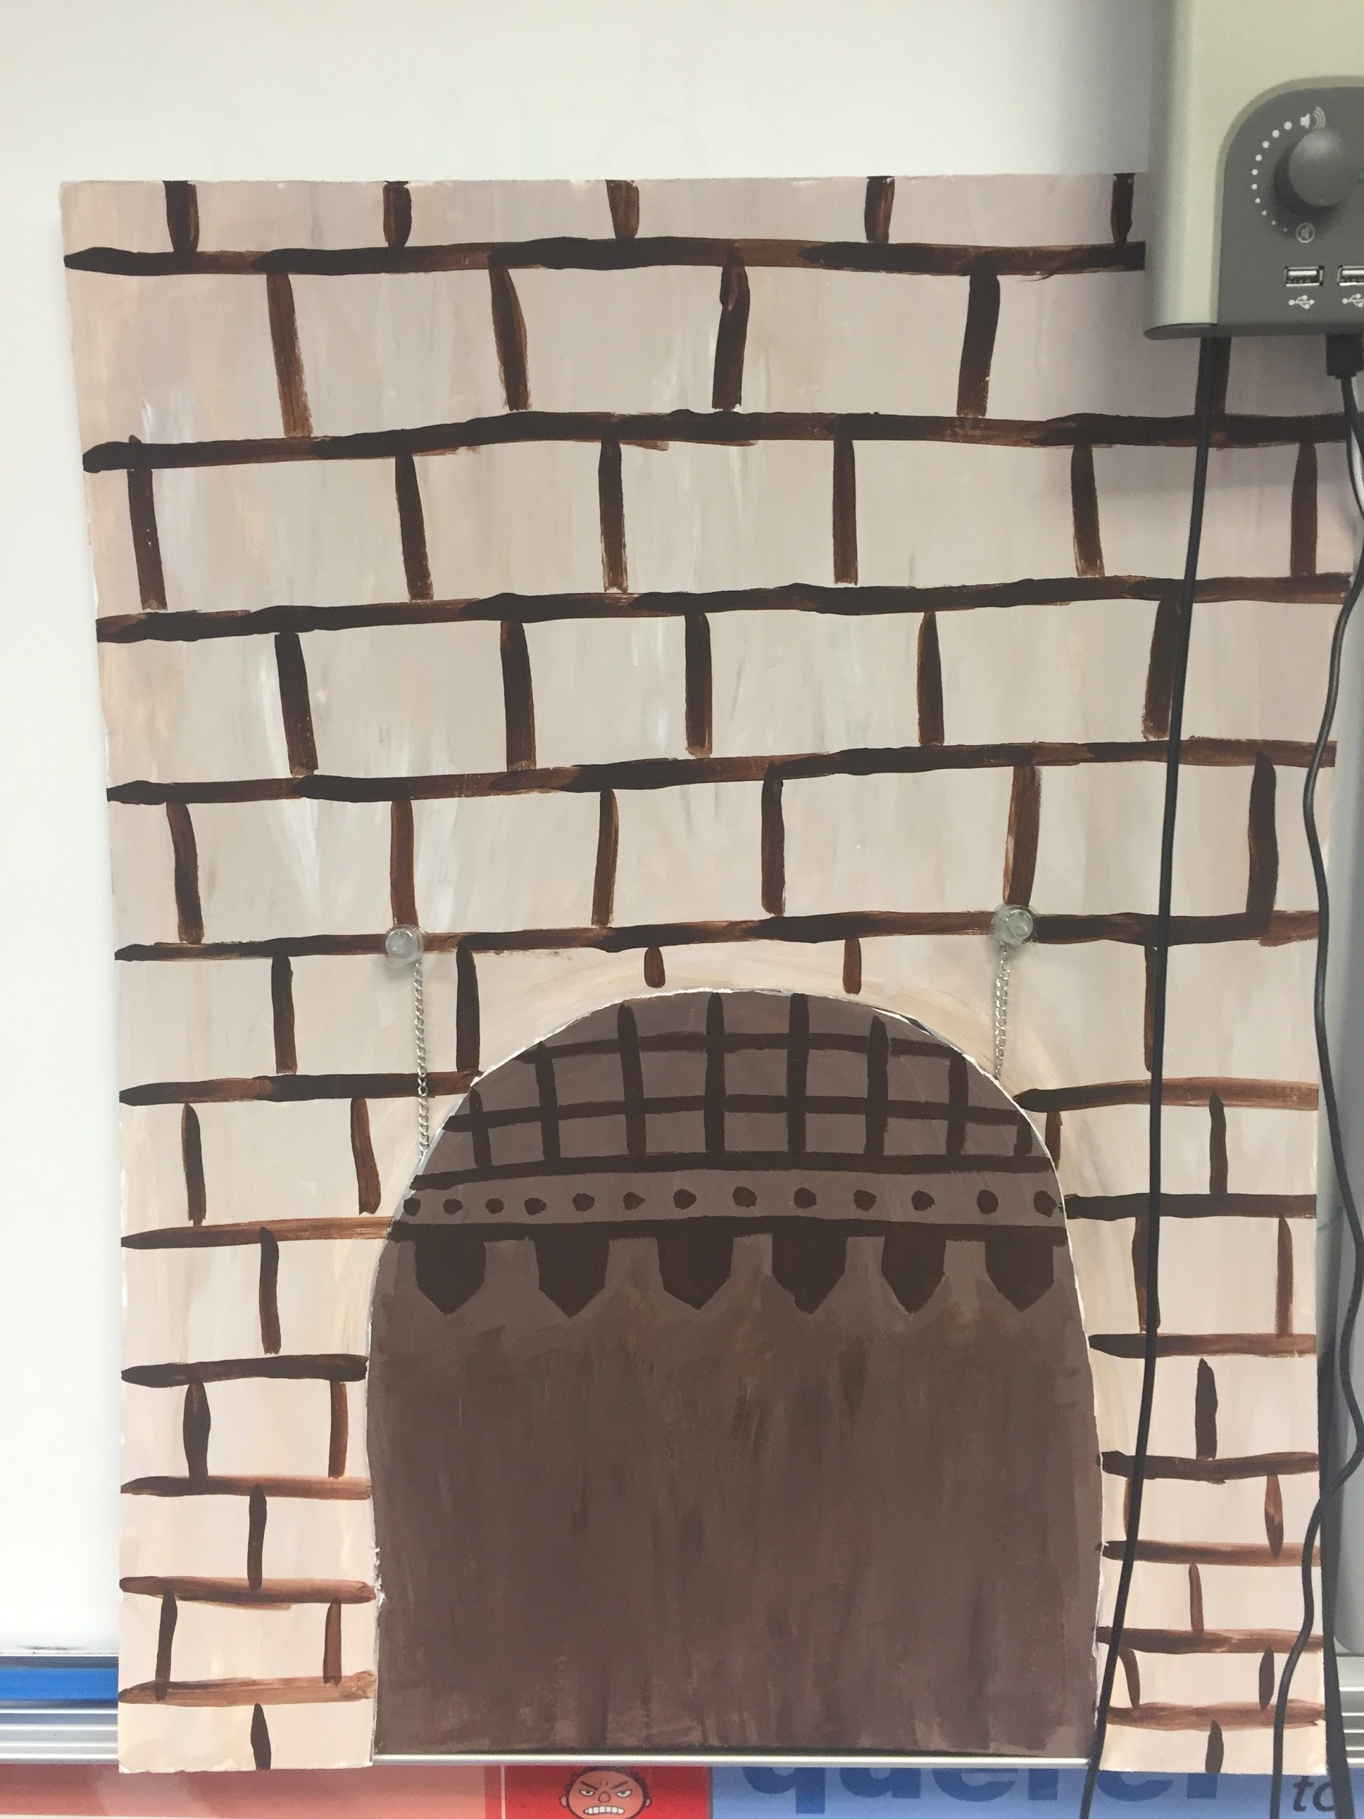
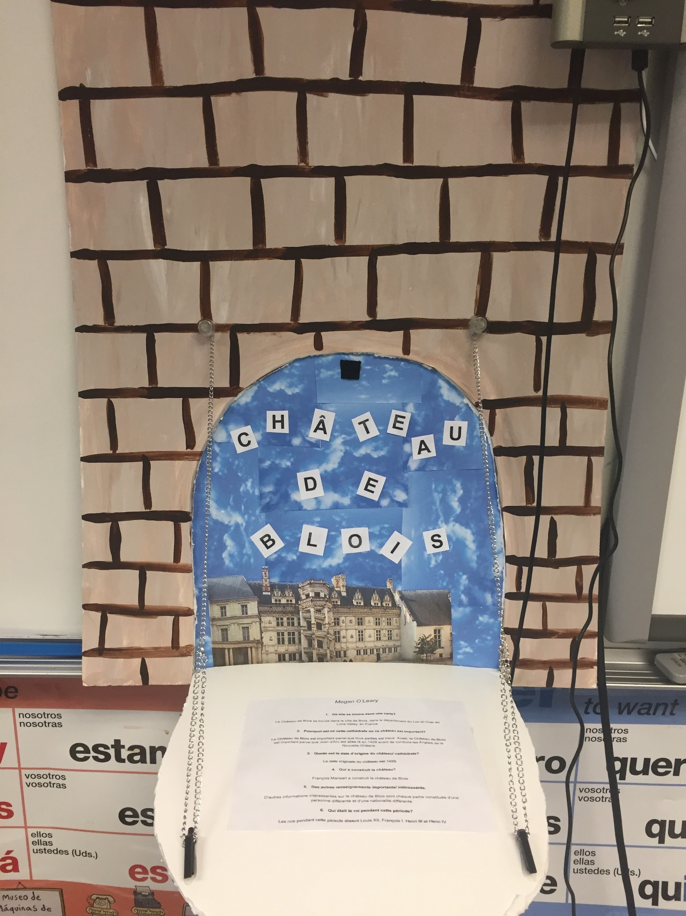
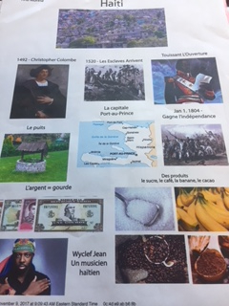
Projects- continued
Level 3- Loire Valley Castle
Time Capsule
Level 4- Timelines
Cartoon series (based on stories)

Slide 21
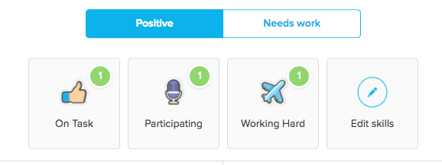
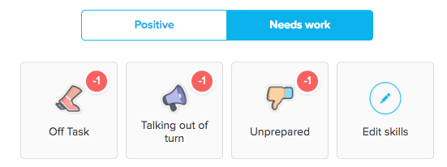
Tracking Class Participation- Class Dojo
Level 1- I create categories
Level 2+- students help create categories

Slide 22
Technology-Driven
Resources: Google Classroom PLUS
https://edpuzzle.com/
https://conjuguemos.com/
https://goformative.com/
https://quizlet.com/
https://www.quia.com/
https://info.flipgrid.com
http://www.wordreference.com/
https://kahoot.com/
http://www.castlelearning.com
https://portaportal.com
https://padlet.com/
https://www.plickers.com/

Slide 23
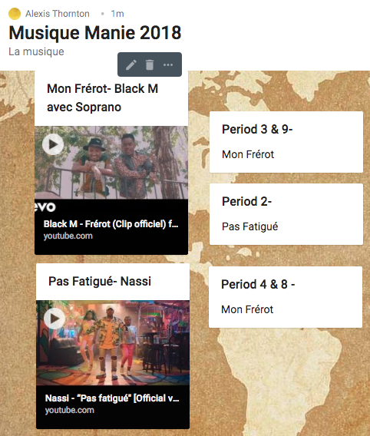
Musique
Music Bracket
- Use padlet.com
to display videos
- Use pollev.com or Google
classroom
to vote daily!

Slide 24
Celebrations/ Culture
National French Week- Twitter contest
Hosting Students
International Dinner
La Chandeleur- Crêpes
Mardi Gras
National Foreign Language Week- Courts métrages
French National Honor Society- community service
Poisson d’avril
Museum/ Theater Trips

Slide 25
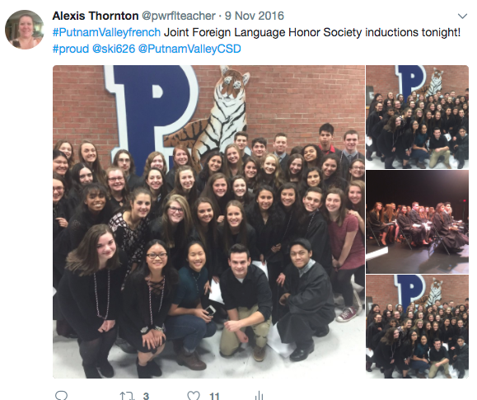
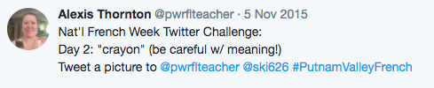
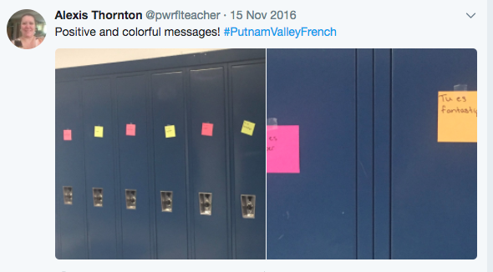
Celebrations

Slide 26



Poisson d’avril
Very specific set of rules! Winning class (by percentage) got a special breakfast!

Slide 27
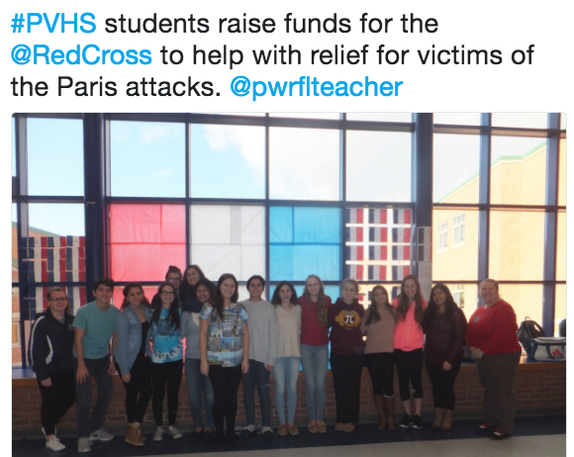
Global Awareness

Slide 28
Teacher Resources:
http://www.education.vic.gov.au/languagesonline/french/french.htm
https://www.tolearnfrench.com
https://fr.islcollective.com/
Conferences!
Facebook Pages:
French Teachers in the US
French Breakout Group
Tech for World Language Teachers
World Language Teachers

Slide 29
Contact
athornton@pvcsd.org
Twitter: @pwrflteacher
Thank you for coming and
please take a business card
in case I can be of further help!

