Slide 1
Advancing Reading
Through Critical Thinking
Marlene Moussa
Lakeland High School
mmoussa@lakelandschools.org
Link to presentation & additional materials:
http://www.lakelandschools.org/webpages/mmoussa/workshops.cfm
PWRFL Spring Conference
March 21, 2015
146 Peekskill Hollow Rd
Putnam Valley NY

Slide 2
Language, Thinking and Reading
are inter-connected
Language
Reading
Thinking
Elkhart Community Schools

Slide 3
Thinking strategies
“True comprehension goes beyond literal understanding and involves the reader’s interaction with text. If students are to become thoughtful, insightful readers, they must extend their thinking beyond a superficial understanding of the text.”
Stephanie Harvey and Anne Goudvis

Slide 4
Teaching for Thinking
Teacher creates a safe environment that encourages all students to think in the WL classroom
Avoid criticism/put-downs
Share point of views without being judged
Creative/original ideas are acceptable
Teacher develops a variety of strategies that helps students to believe in their ability to become confident readers.
Just because the passage is too long it does not mean that it is difficult or cannot be done

Slide 5
Essential Questions High- order Essential Questions which…
Focus the thinking of our students
Encourage critical thinking
Help our students to go beyond the obvious
EQ: How can we develop tools and strategies to improve reading in the World Languages classroom?

Slide 6
Making Connections
Connect to the text: Set a purpose for the reading
What’s the reason for the reading?
Why do I want them to read it?
How meaningful is it in their life?
Do they think about other books they have read?
Do they think about things that happen in the world?
What is their perspective on the selection of the reading?

Slide 7
Las Familias y las comunidades Pre-Reading
Brainstorming:
Ask questions and students will answer expressing ideas and listening to what others are saying
EQ: ¿Creen que los gobiernos deben controlar a los ciudadanos en el uso de las redes sociales?
Anticipation guide: Statement from the reading, agree or disagree.
Admit slip: Give a prompt at the door tied to the topic on the smartBoard.

Slide 8
Pre-Reading (cont.)
Clustering: Topic in center→ students think of ideas, words and questions related to the topic.
Pictures: Post pictures/photos/posters related to the topic around the room along with a question. Groups choose one and answer it.
Word Wall: Pull 6-8 words from the word wall (reading). Students will work in pairs to write a couple of sentences using the words.
Use Paintings/Music/movie clips relating to the topic (La Llorona/Frida Kahlo/Chavela Vargas, El cargador de flores por Rivera/Cajas de carton)

Slide 9
During Reading Chunking
Underline cognates, words you do not know
Stop & say something encourages thinking during reading.
Read silently→share with partner your understanding of the reading→ share your thoughts with the class, ask questions, summarize text so far, what does not make sense… (not too many stops, differentiate by doing this in smaller group)
Identify the main ideas: key words in a sentence, in a paragraph, then go from from literal to inferential

Slide 10
During Reading Questioning
“Questioning is the strategy that keeps readers engaged. When readers ask questions, they clarify understanding and forge ahead to make meaning. Asking questions is at the heart of thoughtful reading.”
Harvey and Goudvis

Slide 11
Thinking critically After reading
Expand vocabulary: Spend time on key vocabulary words (ampliación, palabras de la misma familia)
Title & photos/pictures: Connection between the title and the main idea
Retelling: retell the story using sticky notes
Shrinking sticky notes: summary of reading on index cards →sticky note→sentence strip (summarize with just one main idea.

Slide 12
Thinking critically After reading
Anticipation guide:
Compare your original choices to see if you still think the same after the reading
Do you still have any questions?
What changed your mind?
What have we learned from the reading?
What was the most interesting information you have learned from the reading?

Slide 13
Thinking critically After Reading
Questions:
What will make this article/story more interesting?
What’s the most important thing the author wants you to know?
Why did the author write this article?
Debate:
Groups representing in G6 (Las redes sociales)
Cajas de cartón: Immigration
Act out a scene: Make video with una carta a Dios
Exit slips: Answer the EQ
Before you go tweet what you know

Slide 14
Thinking critically Reciprocal teaching
Students are in groups of four
The summarizer will then give the major points
The questioner will ask questions about unclear sections
The clarifier will discuss the confusing parts
The predictor will guess what will happen next.

Slide 15
Thinking critically Summarizing
3-2-1 Summarize
3 key ideas
2 things difficult
1 question I still have
3 differences between ______ and _______.
2 similarities between them
1 question I still have
(From Literacy Off Ramp)
3 new vocabulary words
2 adjectives
1 sentence

Slide 16
Reciprocal Teaching (Palincsar et al., 1984, 1986) Reciprocal Teaching worksheet
Students take notes on the worksheet and stop at a given point.
The summarizer will then give the major points
The questioner will ask questions about unclear sections
The clarifier will discuss the confusing parts
The predictor will guess what will happen next.

Slide 17
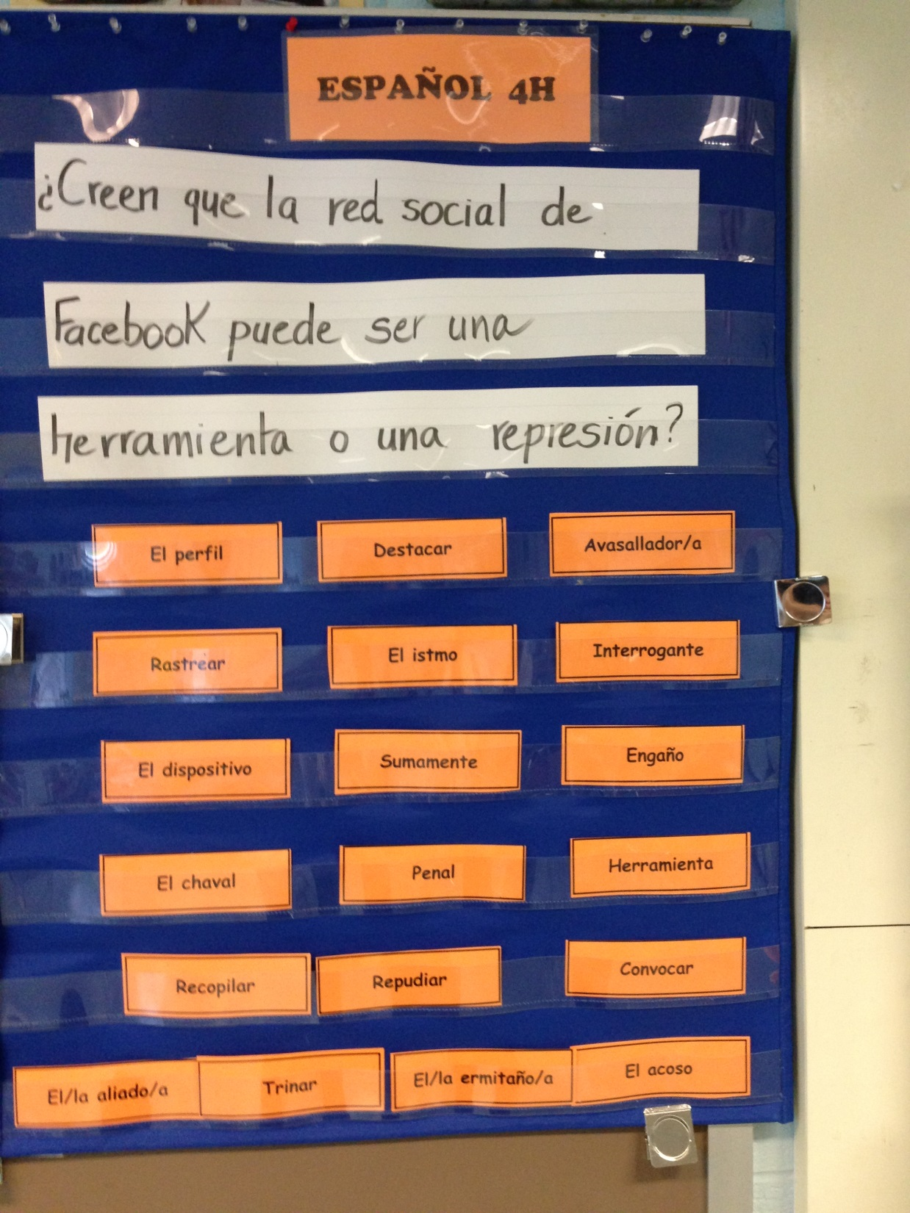
Word Wall

Slide 18
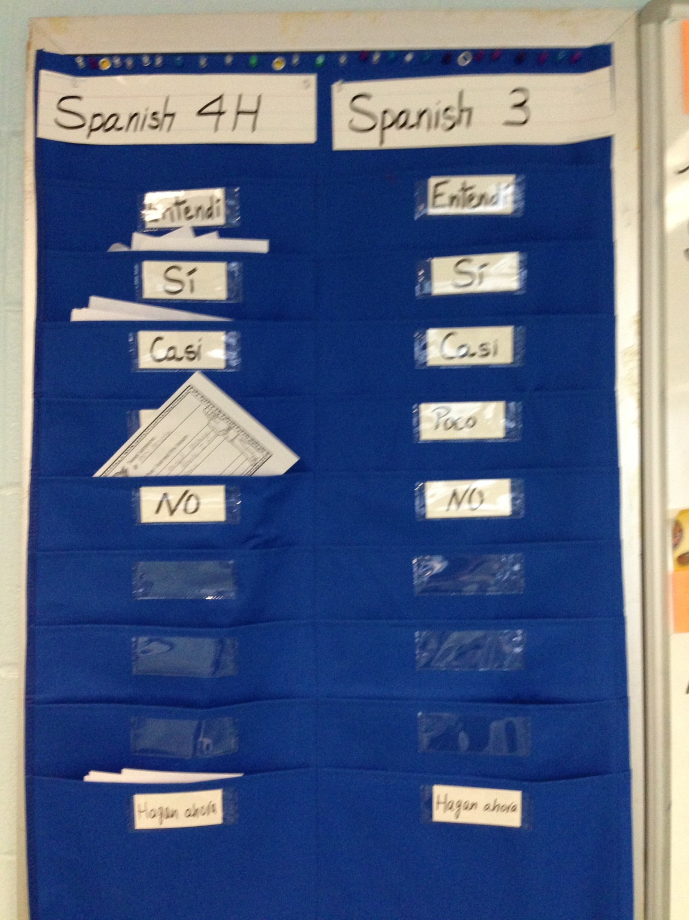
Summarize

Slide 19
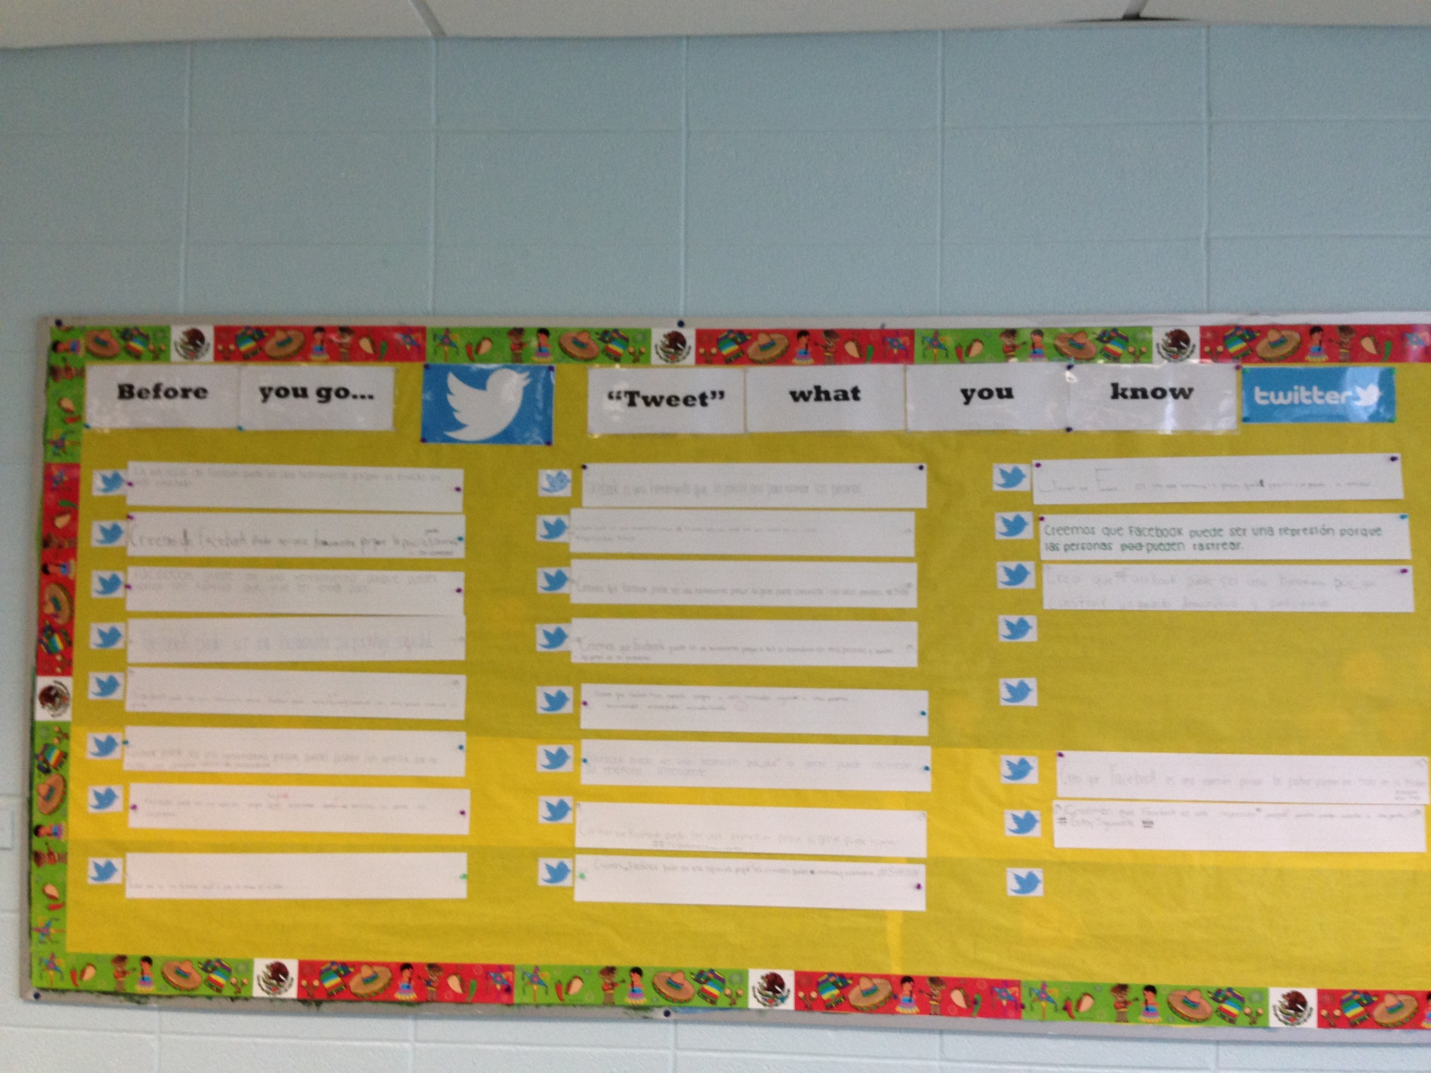
Tweet

Slide 20
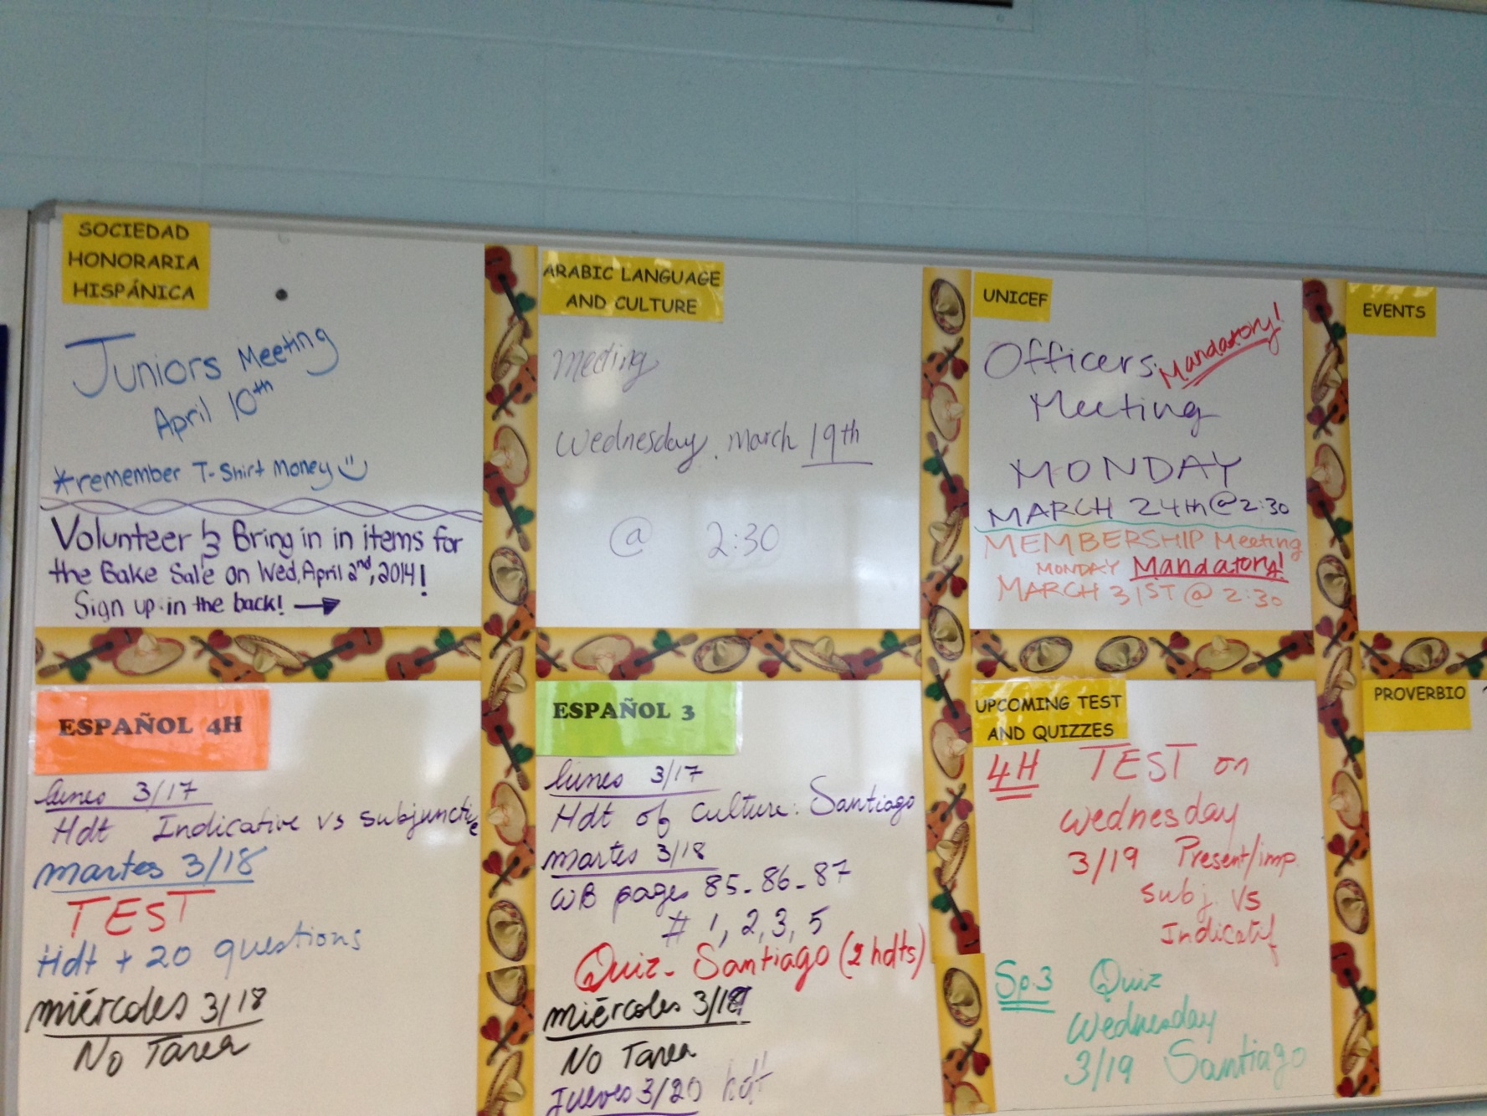

Slide 21
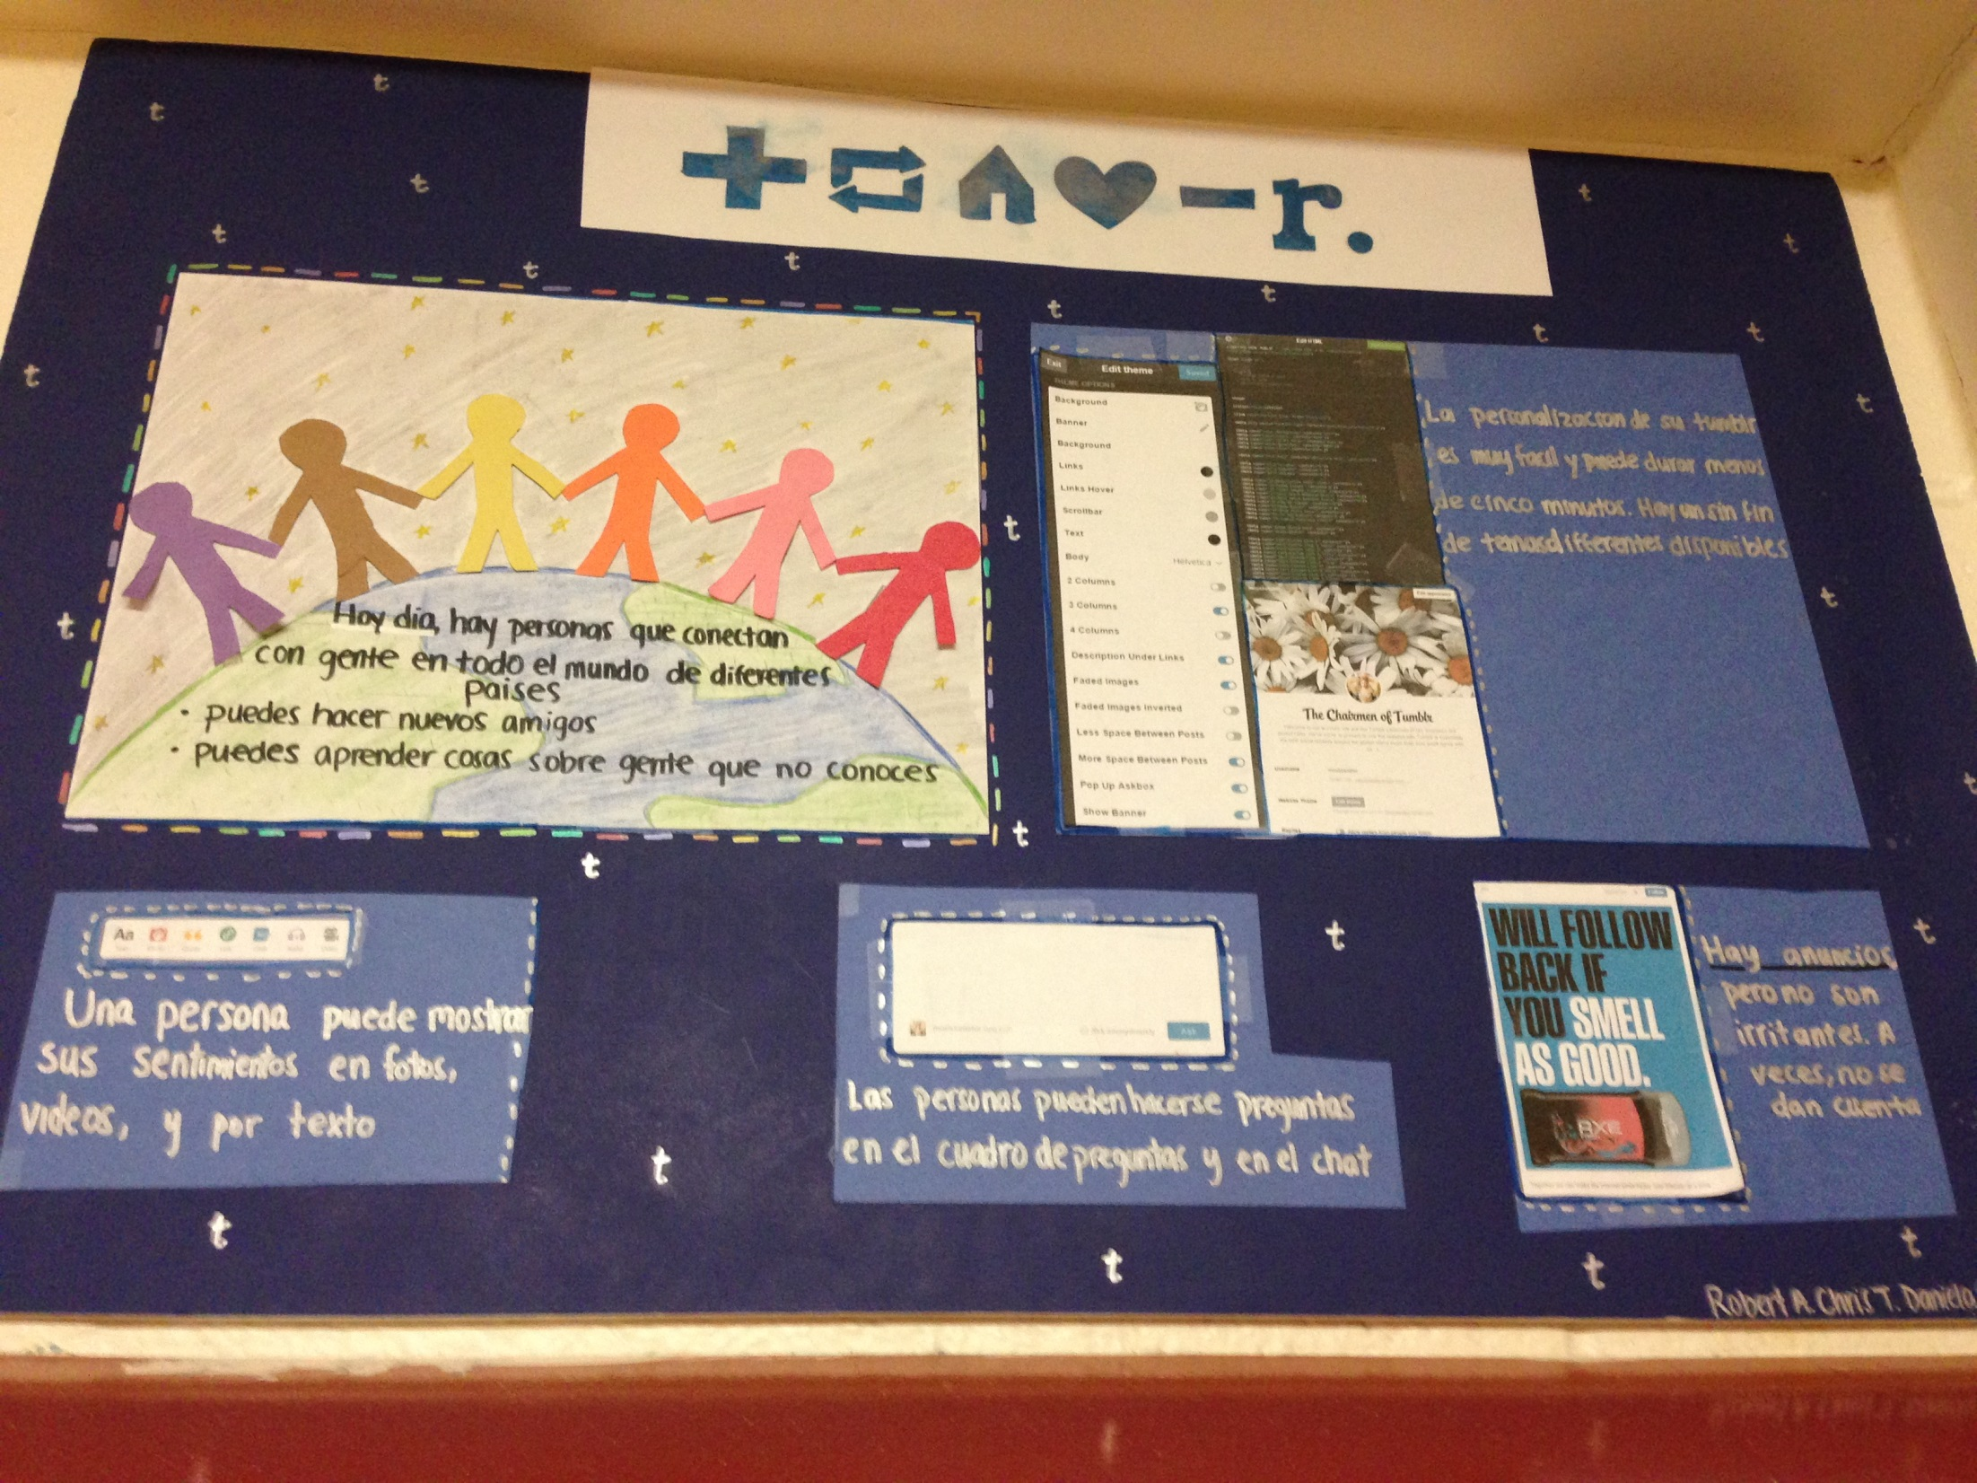

Slide 22
