Slide 7
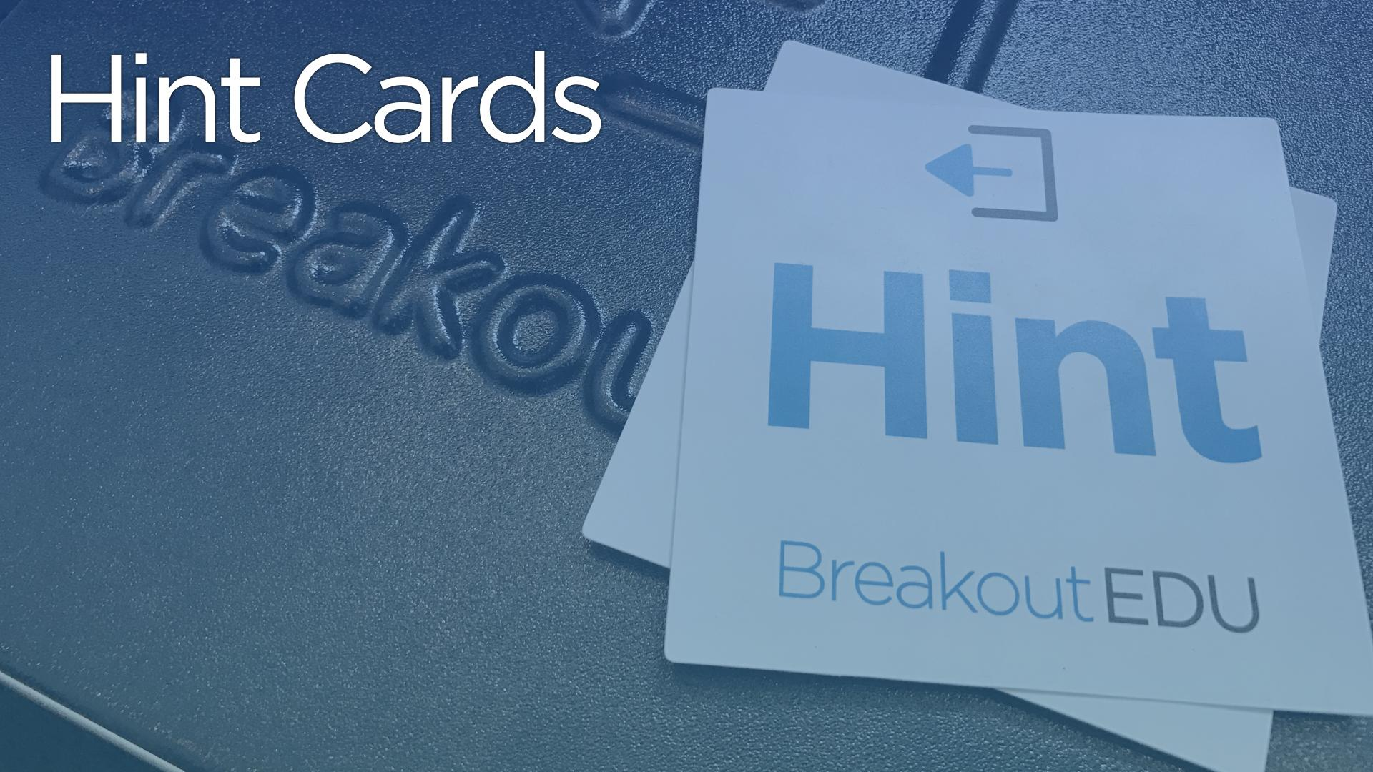

Slide 10
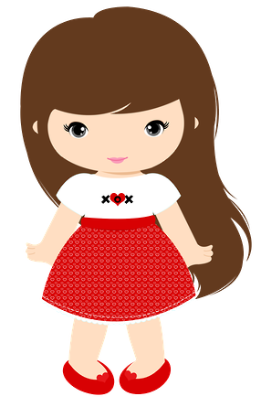
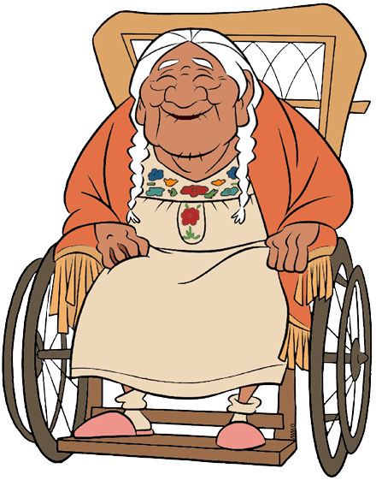
Noemie ayuda a su abuela a preparar la ofrenda para celebrar el Día de los Muertos.
Pero hay un problema… uno de los símbolos está adentro de la caja cerrada y ¡la abuela no recuerda dónde están las llaves!
Ayúdala a encontrar las llaves.

Slide 11
Game Timer

Slide 15
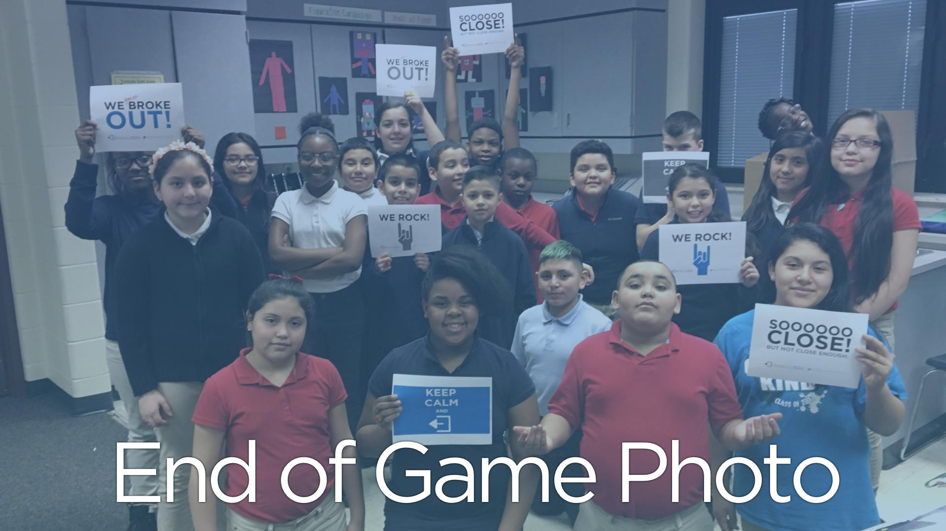

Slide 16
TEACHER EDITION

Slide 17
Set up: work with what you’ve got
Physical needs:
box that can close completely
locks (see packet)
hasp (see Lowe’s)
Optional additions:
blacklight/UV marker
USB
extra boxes
Tips and tricks:
Fill out the packet with your combos and notes
Use different ink colors for different breakouts
Use AC Moore coupons and ask for teacher discounts ☺

Slide 18
Set up: work with what you’ve got
Educational considerations:
Align with theme/unit
Create an educational objective and a “story” objective (content, purpose, background)
Plan using “Game Template”
Optional considerations:
less locks = shorter play time
class size matters
LAMINATE EVERYTHING
Tips and tricks:
Usually intro or culmination of unit
Game template is to submit; may use own style
Start with 2 locks 1st time
Usually 20 or less
Color coding or some special distinction

Slide 19
Set up continued
Optional considerations:
try a run through with a colleague
download game intro presentation
debrief is where the magic happens
digital breakouts require tech only
Tips and tricks:
Remind them to use 2 hints
Group photo=massive community building
Use the Youtube timers for dramatic background noise

Slide 20
For those that like lists:
Make/choose a “story (content, purpose, background)
Determine length
*Choose classes*
Design puzzles and clues
Set up and test
Explain process to students
Play
Debrief
Optional notes

Slide 21
Suggestions and pointers:
PLEASE DO THIS:
Laminate everything for reuse (not kidding; use tape!)
Make a map of the room for clean-up, help!, and reset (blank copies too)
Choose and mark no-go zones to maintain order and protection
DON’T let them play with locks!!! (Use “parking lot”)
Maybe do this:
Vis-à-vis for less residue and more reuse
Graphic organizer for retention of material
Include red herrings; hide in plain sight; encourage them to switch jobs

Slide 22
Questions and “más allá”:
Last look:
Check Facebook, Pinterest, Google even, for ideas! (free= )
Incorporate tech (Google cardboard/VR/QR codes)
Differentiate and scaffolding: -If really unfinished, can continue next day (“seeking” is over) -less to no movement; less team building, more content driven, -best in smaller groups→split room, color code, ½ play ½ library day
Once a quarter maximum
Questions?

Slide 23
Thank you for coming!
https://goo.gl/q6PRXK
Feedback survey link:

