Slide 1
Whiteboards Reimagined!
Alexis Thornton
ALOUD Regional 5-11-19

Slide 2
1- *Verb Passing Game
Each row will have one whiteboard to pass but each person will have their own marker.
Ground rules: no flinging the whiteboards, each person answers one question at a time, you can correct anyone’s mistakes at any team but you are a team so work together. You must include subject pronouns when answering!
Rows of 3: first chair answers 2 questions, middle chair answers 3 questions and serves as final anchor, back chair answers 1 question
Objective: correctly conjugate all 6 verb forms in whichever tense you are studying (1st correct team gets 2 points, each additional correct team gets 1 point per round).
See example round on next page.
Notes:
Need whiteboards, markers, towels, jumbo post-its

Slide 3
Example round
For the first game we will work on conjugating verbs in the present tense (in English).
1- I (to run) 4- They (to speak)
2- He (to say) 5- She (to walk)
3- We (to jump) 6- You (to write)
Alternative: translate vocabulary from English→TL or picture→TL

Slide 4
2- Battleship
Each person draws a 5x5, 6x6, etc chart.
Label x-axis with letters and y-axis with numbers.
Place # of battleships desired on your game.
Take a different colored marker to keep track of which boxes you have called for your partner.
Alternatives: use numbers that are factors of 10 or 100

Slide 5
3- Hangman
Use vocabulary to create a challenge word for your partner. They must guess by using letters.

Slide 6
4- Paragraph writing
First person starts a story “once upon a time in…”
Pass the board when the signal is given to continue the story (can change tenses, situations, etc.)

Slide 7
5- *MASH
One student records their partner’s 3 options for each category. Then a number is chosen and the students begin to count off in TL and cross off the option when they land on their number. Continue until there is only one option left per category. Possible Categories:
Type of vehicle Types of activities you will do on vacation
Color of vehicle Profession
Number of kids Age you will go gray
Pets
Alternative: write a paragraph with final options
Notes:
Copies of mash game

Slide 8
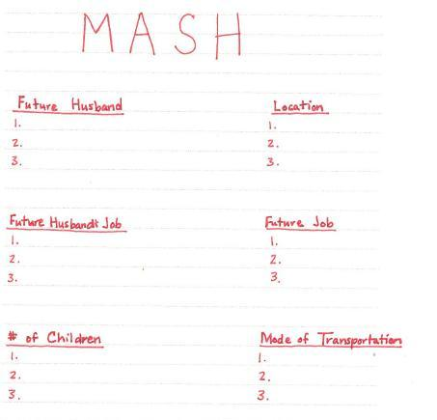
Image obtained from Creativecommons.org- labeled for reuse

Slide 9
6- *Descriptive People
One partner gives descriptions of the person/ situation that they would would like their partner to design. (KNOW YOUR CLASSES IF DOING BODY PARTS!)
Lower level- student just has to read a description in TL off an index card
Advanced level- student is given a picture and has to generate description in TL themselves to give their partner

Slide 10
7- Mrs. Thornton’s Bingo
Students see a list of words displayed on a screen. They must choose 4 and write one in each of the four corners of their board. If the teacher says one of the words that they have chosen, they cross it out.
Lower Level- Translation English- TL
Advanced Level- Definitions in TL

Slide 11
8- Vocabulary Practice
Each part of the whiteboard is used for a different activity. The word goes in the middle, one corner gets a picture to represent the word, one corner gets a synonym, another corner is for a definition of the word (in English or TL) and the last corner is for a sentence using the word.

Slide 12
9- Scattergories
Write one example for each category and be creative!
Instructions: Everybody then stands. I will ask for your word for a category. If someone else has the same word, you get no points. If you are the only person to have thought of a word, you get a point.
- Un numéro entre 1 et 10
- un animal
- un membre de la famille

